Slide 1
8.6 Code Generation in Commercial Compilers
( x = x +3 ) + 4
mov ax, word ptr [bp-2]
add ax, 3
mov word ptr [bp-2], ax
add ax, 4

Slide 2
The Borland 3.0 C Compiler for the 80X86
8.6 Code Generation in Commercial Compilers
1) Array Reference
A example:
( a [ i + 1 ] = 2 ) + a [ j ]
int i,j;
int a[10]
( 1 ) mov bx, word ptr [bp-2]
( 2 ) shl bx , 1
( 3 ) lea ax, word ptr [bp-22]
( 4 ) add bx , ax
( 5 ) mov ax , 2
( 6 ) mov word ptr [bx], ax
( 7 ) mov bx, word ptr [bp-4]
( 8 ) shl bx , 1
( 9 ) lea dx, word ptr [bp-24]
( 1 0 ) add bx , dx
( 1 1 ) add ax, word ptr [bx]

Slide 3
The Borland 3.0 C Compiler for the 80X86
8.6 Code Generation in Commercial Compilers
2) Pointer and Field References
  typedef struct rec
  { int i; offset 0
  char c; offset 2
  int j; offset 3
  } Rec; // alignas(2)
  typedef struct treeNode
  { int val; offset 0
  struct treeNode * lchild, * rchild; offset 2 , offset 4
  } TreeNode;
  …
  Rec x; (have 5 bytes) bp -6
  TreeNode *p; (2 bytes “near” pointers) register si
  x.j = x.i mov ax, word ptr [bp-6]
  mov word ptr [bp-3], ax
  p->lchild = p mov word ptr [si+2], si

Slide 4
8.6 Code Generation in Commercial Compilers
The Borland 3.0 C Compiler for the 80X86
3) If and While-Statement
if (x>y) y++; else x--;
cmp bx , dx
jle short @1@86
inc dx
jmp short @1@114
@1@86 :
dec bx
@1@114 :
bx <- x
dx <- y

Slide 5
8.6 Code Generation in Commercial Compilers
while (x<y) y -= x;
jmp short @1@170
@1@142 :
sub dx , bx
@1@170 :
cmp bx , dx
jl short @1@142
the test is placed at the end, and an initial unconditional jump is made to this test.
bx <- x
dx <- y

Slide 6
The Borland 3.0 C Compiler for the 80X86
8.6 Code Generation in Commercial Compilers
4) function definition and call
  int f( int x, int y)
  { return x+y+1 ；}
  f (2+3, 4)
  _f proc near
  push bp
  mov bp,sp
  mov ax, word ptr [bp+4] ; x
  add ax, word ptr [bp+6] ; +y
  inc ax ; +1
  jmp short @1@58
  @1@58:
  pop bp
  ret
  _f
  mov ax,4
  push ax
  mov ax,5
  push ax
  call near ptr _f
  pop cx
  pop cx
- 参数从右到左入栈
- caller最后2个pop弹出并抛弃参数

Slide 7
8.9 A Survey of Code Optimizations Techniques
The quality of the code can be measured by the speed and the size of the target code.
It is important to realize that a compiler writer cannot hope to include every single optimization technique that has ever been developed.
techniques are most likely to result in a significant code improvement with the smallest increase in the complexity of the compiler.

Slide 8
8.9.1 Principal Sources of Code Optimizations
the areas in which a code generator may fail to produce good code:
1) Register Allocation :Good use of registers is the most important feature of efficient code. Historically, the number of available registers was severely limited.
One approach: (x86 approach)
increase the number and speed of operations that can be performed directly in memory.
Another approach: (the so-called RISC approach)
  decrease the number of operations that can be performed directly in memory (often to zero); increase the number of available registers to 32, 64 or 128. In such architectures proper register allocation becomes even more critical.

Slide 9
8.9.1 Principal Sources of Code Optimizations
2) Unnecessary Operations:
The second major source of code improvement is to avoid generating code for operations that are redundant or unnecessary.
This kind of optimization :
  a very simple search of localized code
  complex analysis of the semantic properties of the entire program.
avoiding storing the value of a variable or temporary that is not subsequently used.
  Unreachable or dead code
  #define DEBUG 0
  …..
  if (DEBUG)
  {………}

Slide 10
8.9.1 Principal Sources of Code Optimizations
3) Costly Operations
A code generator: to reduce the cost of operations that are necessary.
The replacement of arithmetic operations by cheaper operations.
For instance
  multiplication by 2 can be implemented as a shift operation.
  a small integer power, such as x³, can be implemented as a multiplication, such as x*x*x.
This optimization is called reduction in strength.

Slide 11
8.9.1 Principal Sources of Code Optimizations
Constant folding: use information about constants to remove (to precompute) as many operations as possible
Constant propagation: if a variable might also have a constant value for part or all of a program.

Slide 12
8.9.1 Principal Sources of Code Optimizations
Two standard ways to remove procedure calls:
1. replacing the procedure call with the code for the procedure body (with suitable replacement of parameters by arguments). (Procedure in-lining)
2. recognize tail recursion:
  when the last operation of a procedure is to call itself.

Slide 13
8.9.1 Principal Sources of Code Optimizations
int gcd ( int u, int v)
{ if (v == 0) return u;
else return gcd(v, u%v);} // is a tail recursive
int fact (int n )
{ if (n==0) return 1;
else return n*fact(n-1); } // is not a tail recursive

Slide 14
8.9.1 Principal Sources of Code Optimizations
  - tail recursion removal
int gcd( int u, int v)
{ begin:
if ( v==0) return u;
else
{ int t1 = v, t2 = u%v;
u = t1; v = t2;
goto begin;
}
}

Slide 15
8.9.1 Principal Sources of Code Optimizations
4) Prediction Program Behavior:
To perform some of the previously described optimizations, a compiler must collect information about the uses of variables, values and procedures in programs, e.g.
whether expressions are reused
whether or when variables change their values or remain constant
whether procedures are called or not.
A different approach is taken by some compilers: (profiling)
statistical behavior about a program is gathered from actual executions
which paths are most likely to be taken
which procedures are most likely to be called often
which sections of code are likely to be executed the most frequently.

Slide 16
8.9.2 Classification of Optimizations
Two useful classifications :
  the time during the compilation process when an optimization can be applied .
  the area of the program over which the optimization applies.

Slide 17
8.9.2 Classification of Optimizations
1、The time:
e.g. constant folding can be performed as early as during parsing.
Some optimizations can be delayed until after target code has been generated (peephole optimizations).
Typically the majority of optimizations are performed
  during IR gen.
  after IR gen.
  during target code generation.
  source-level optimization
  target-level optimization

Slide 18
8.9.2 Classification of Optimizations
in ordering the various optimizations, it is important to consider the effect that one optimization may have on another.
x = 1;
. . .
y = 0;
. . .
if (y) x = 0;
. . .
if (x) y = 1;
x = 1;
. . .
y = 0;
. . .
if (0) x = 0;
. . .
if (x) y = 1;
x = 1;
. . .
y = 0;
. . .
if (x) y = 1;
Constant propagation applied first

Slide 19
8.9.2 Classification of Optimizations
2、The area of operation
(1) local optimizations: applied to straight-line segments of code, or basic blocks. That is, code sequences with no jumps into or out of the sequence.
(2) Global optimizations: applied to an individual procedure. Loop discovery are necessary
(3) Inter-procedural optimizations: extend beyond the boundaries of procedures to the entire program. Inter-procedural optimization is even more difficult.

Slide 20
8.9.3 Data Structures and Implementation Techniques for Optimizations
Some optimizations can be made by transformations on the syntax tree itself, including constant folding and unreachable code elimination.
an optimizer construct a graphical representation of the code called a flow graph.
  The nodes of a flow graph are the basic blocks.
  The edges are formed from the conditional and unconditional jumps.
  Each basic block node contains the sequence of intermediate code instructions of the block.

Slide 21
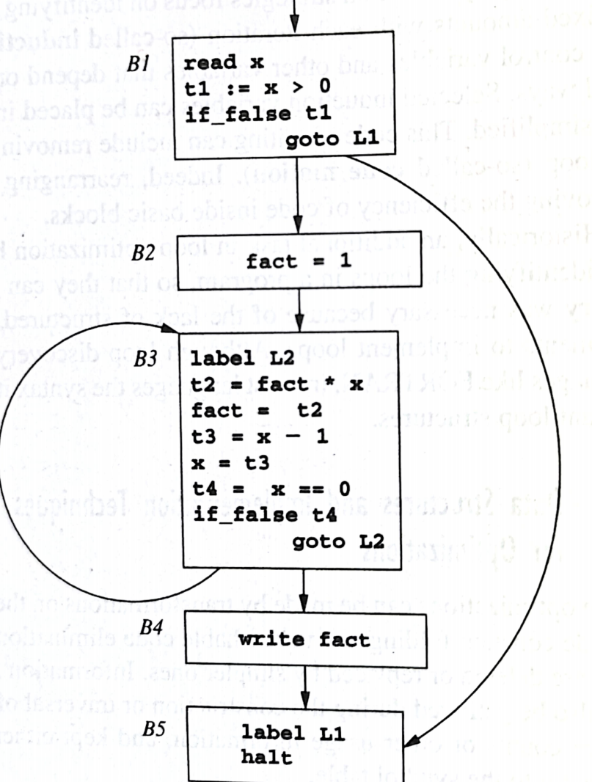
8.9.3 Data Structures and Implementation Techniques for Optimizations
A flow graph, together with each of its BBs, can be constructed by a single pass over the intermediate code. Each new BB is identified as follows:
(1) The first instruction begins a new BB;
(2) Each label that is the target of a jump begin a new BB;
(3) Each instruction that follows a jump begins a new BB;

Slide 22
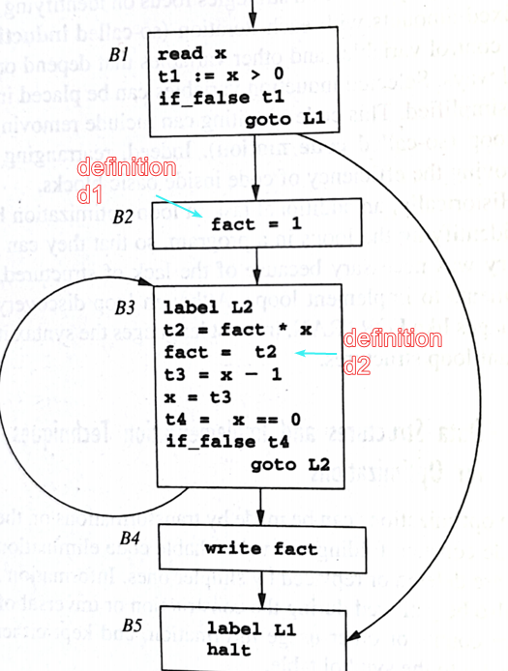
8.9.3 Data Structures and Implementation Techniques for Optimizations
A standard data flow analysis problem is to compute, for each variable, the set of so-called reaching definitions of that variable at the beginning of each BB.
  A definition: an IR instr. that sets the variable. E.g. →
  A definition reach a BB if at the beginning of the BB the variable can still have the value established by this definition.
  E.g. d1 reaches B3; d2 reaches B4 and B5
  Reaching definitions can, e.g. be used in constant propagation.

Slide 23
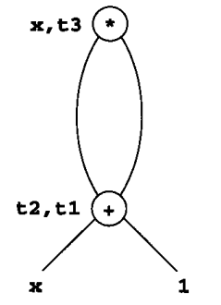
8.9.3 Techniques for Optimizations
- DAG of a BB & Common Sub-Expressions Elimination
For example, the C assignment x = (x+1)*(x+1) translates into the three-address instructions:
t1 = x + 1
t2 = x + 1
t3 = t1 * t2
x = t3
Repeated use of the same value is represented in the DAG structure.
t1 = x + 1
x = t1 * t1

Slide 24
8.9.3 Data Structures and Implementation Techniques for Optimizations
DAG traces the computation and reassignment of values and variables in a BB as follows.
  (1) Values that come from elsewhere are represented as leaf nodes.
  (2) Operations on those and other values are represented by interior nodes.
  (3) Assignment of a new value is represented by attaching the name of the target variable or temporary to the node representing the value assigned.

Slide 25
8.9.3 Data Structures and Implementation Techniques for Optimizations
Construction of DAG involves two dictionaries.
(1) A table containing variable names and constants, with a lookup operation that returns the DAG node to which a variable name is currently assigned.
(2) A table of DAG nodes, with a lookup operation that, given an operation and child node, returns the node with that operation and children or nil if there is no such node.
Target code, or a revised version of intermediate code, can be generated from a DAG by a traversal according to any of the possible topological sorts of the non-leaf nodes.

Slide 26
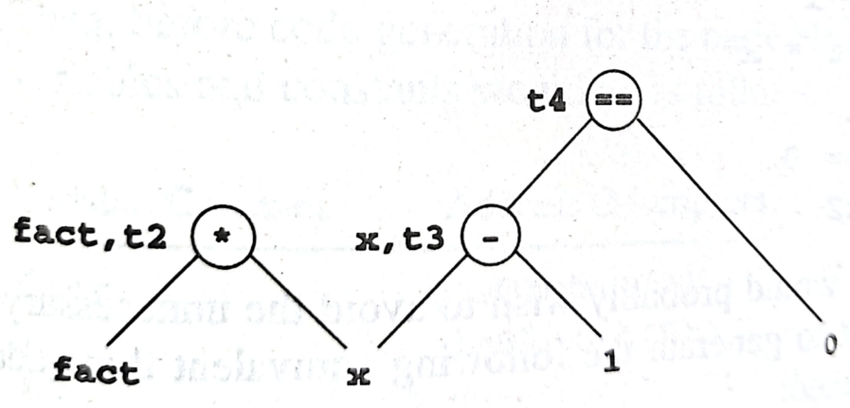
8.9.3 Data Structures and Implementation Techniques for Optimizations
the original BB:
    t3 = x - 1
    t2 = fact * x
    x = t3
    t4 = x == 0
    fact = t2
Avoid temp
new sequence of three address instructions
    fact = fact * x
    x = x - 1
    t4 = x == 0

Slide 27
8.9.3 Data Structures and Implementation Techniques for Optimizations
Using DAG, we:
automatically get local common subexpression elimination.
eliminate redundant stores .
get reference count -> good register allocation!

Slide 28
8.9.3 Data Structures and Implementation Techniques for Optimizations
A final mothod that is often used to assist register allocation as code generation proceeds involves the maintenance of data called register descriptors and address descriptors.
Register descriptors: associate with each register a list of the variable names whose value is currently in that register.
Address descriptors: associate with each variable name the locations in memory where its value is to be found.

